Slide 1
Big Data Analysis With IBM Cloud Databases
INNOVATION

Slide 2
Introduction
In an era defined by data abundance, the presentation sets the stage by underscoring the critical need for sophisticated analytics. Traditional methods struggle to cope with the sheer scale and diversity of big data, prompting a deep dive into the integration of advanced machine learning.
The journey commences with a comprehensive exploration of predictive analytics, showcasing its transformative impact across industries. From predicting market trends to understanding user behavior, advanced machine learning algorithms, including regression, decision trees, and ensemble methods, emerge as indispensable tools.

Slide 3
Abstract
In an era dominated by data, the ability to extract meaningful insights from vast and diverse datasets is paramount. This presentation delves into the world of advanced machine learning algorithms, exploring their role in predictive analytics and anomaly detection within the realm of big dataThis section dives into the core of predictive analytics, exploring the intricacies of machine learning algorithms. Emphasis is placed on the significance of feature engineering and rigorous model evaluation to ensure accurate predictions.

Slide 4
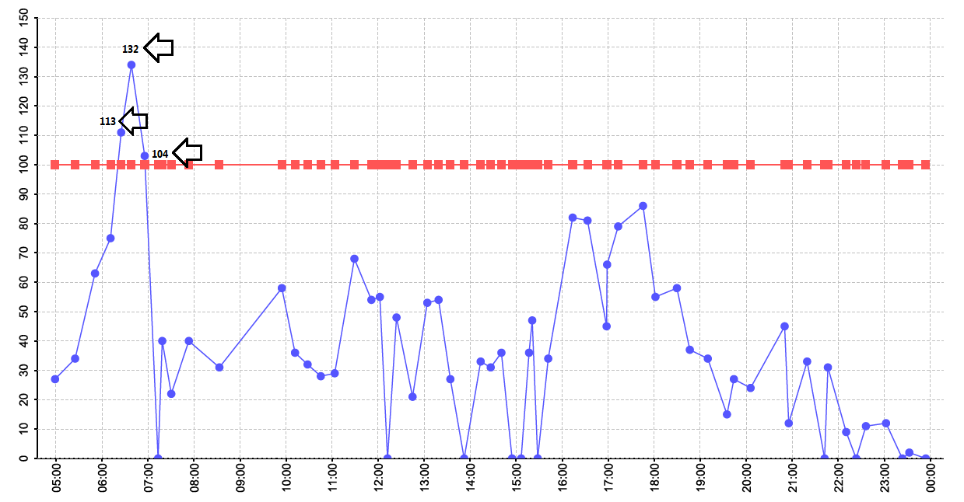
Big data graph
This Photo by Unknown Author is licensed under CC BY-SA

Slide 5

Machine Learning for Predictive Analytics
Overview of machine learning algorithms suitable for predictive analytics.
A brief explanation of regression, decision trees, and ensemble methods.
The importance of feature engineering in enhancing the performance of predictive models.
Real-world examples illustrating the impact of well-crafted features on predictive accuracy.
This Photo by Unknown Author is licensed under CC BY

Slide 6
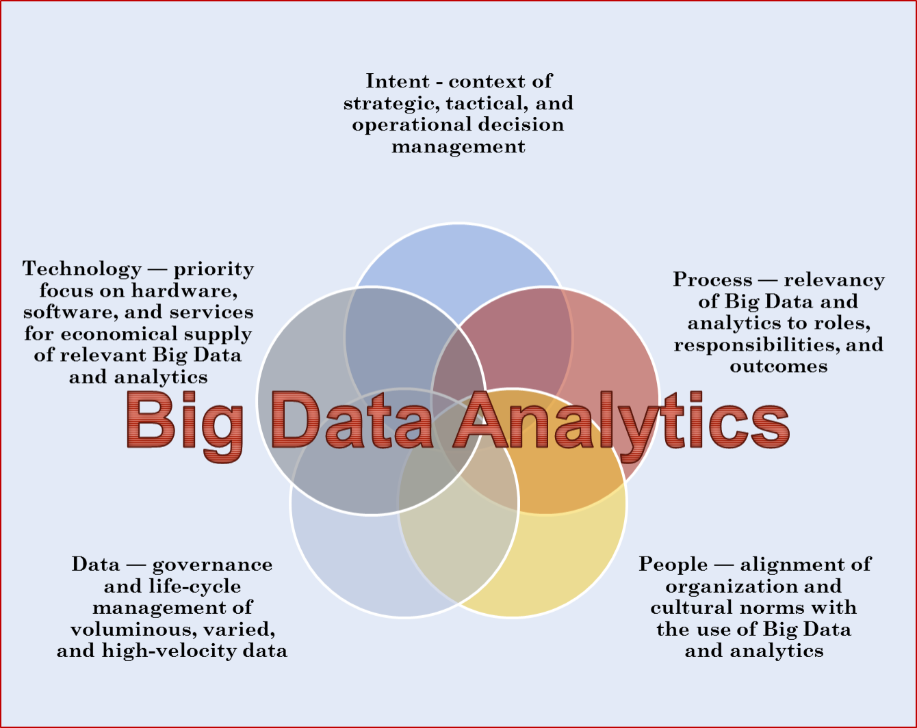
This Photo by Unknown Author is licensed under CC BY-SA-NC

